Slide 1
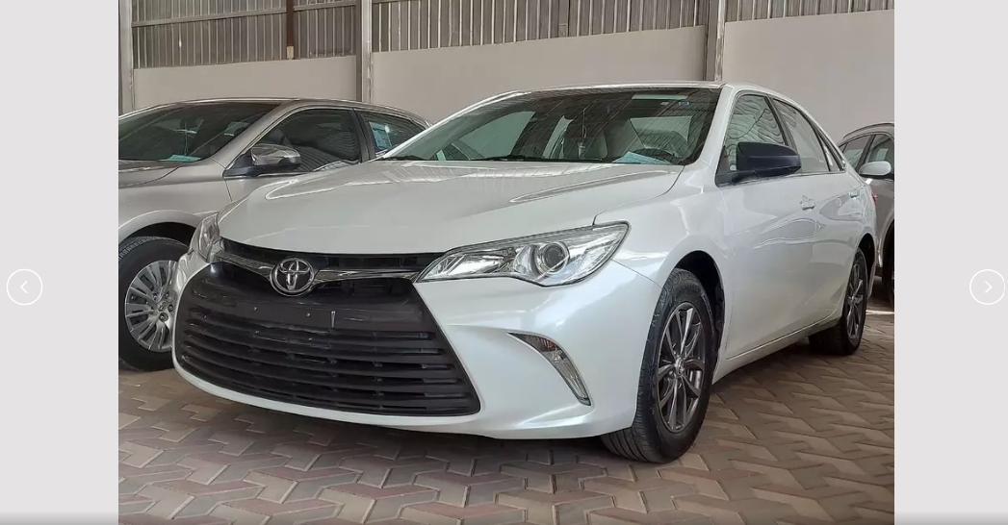
USED CAR PRICE PREDICTION
PROJECT CAPSTONE MODUL 3 : MACHINE LEARNING
By: Risdan kristori

Slide 2
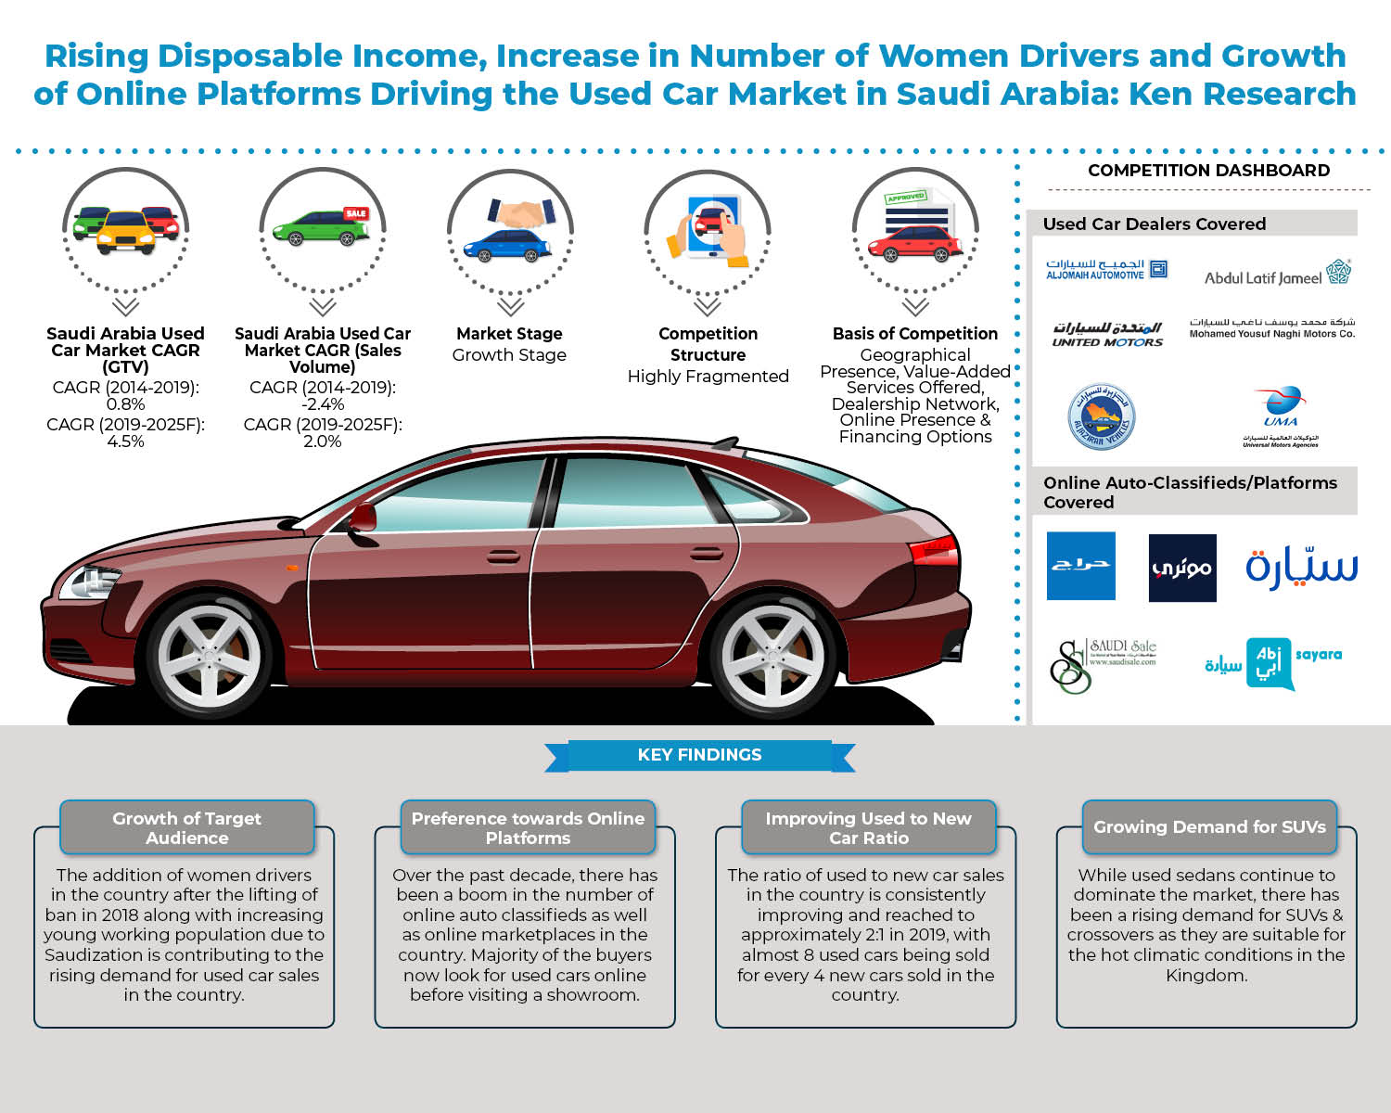
BUSINESS PROBLEM
Saudi Arabia used car market will increase by 4.5% and volume will increase by 2.0% in 2025. Because:
Increasing number of female drivers (which was previously prohibited)
Growth of the online market for used car
Covid-19 causes the stock of used cars to increase and income to decrease. Cause people to be more interested in buying a used car instead of a new car

Slide 3
BUSINESS PROBLEM
The problem in the used car business is that the price is uncertain:
The seller or buyer of a used car is not a car dealer who knows the price trend of a car.

Slide 4
GOAL
This project aims to help sellers and buyers of used cars determine the price of a used car, in order to increase used car buying and selling transactions in online platform.

Slide 5
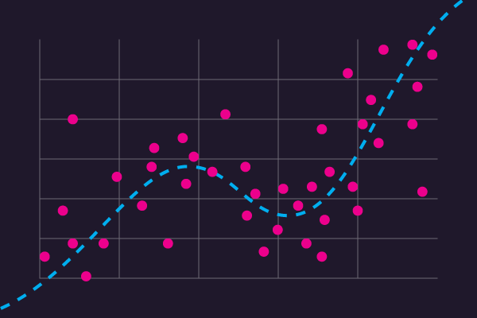
ANALYTIC APPROACH
The model that will be made uses a regression algorithm using the features contained in the car
The model to be tested is the base model and the ensemble model
Then it will be selected using the evaluation matrixs: RMSE or MAE

Slide 6
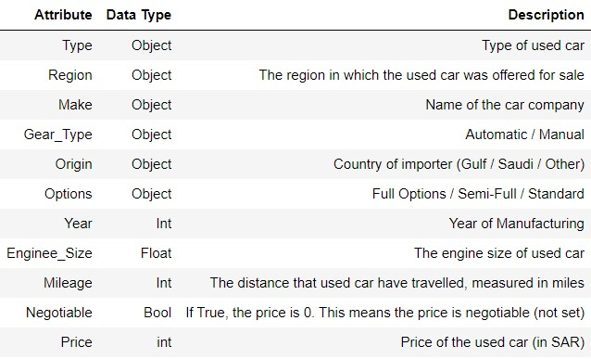
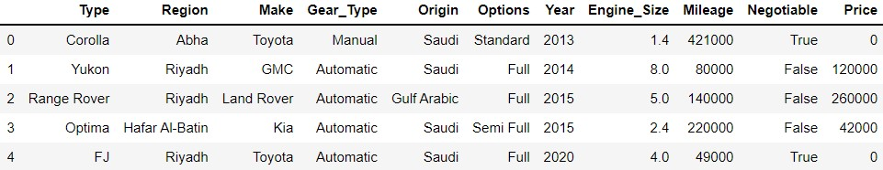
DATA USED CAR
Data from Purwadhika Tech School.
Lets assume data from Syarah.com web (website selling used car in Saudi Arabia).

Slide 7
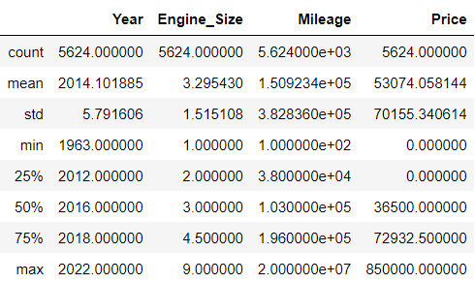
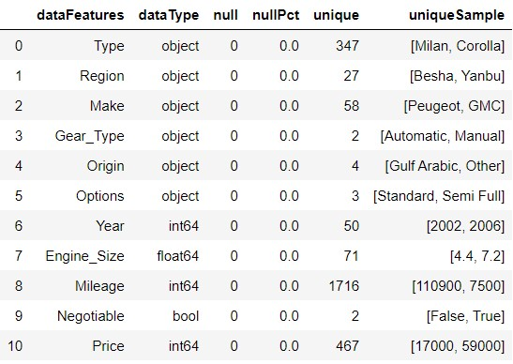
DATA USED CAR

Slide 8
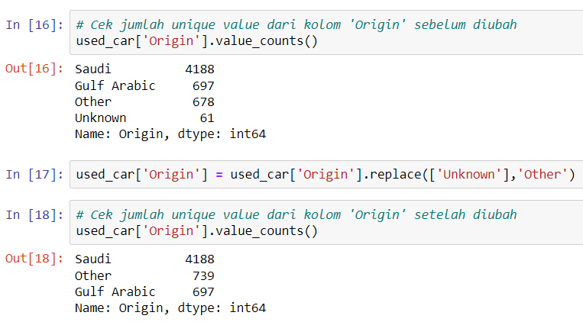
DATA CLEANING
1. Change ‘unknown’ value to ‘other’ value in Origin feature

Slide 9
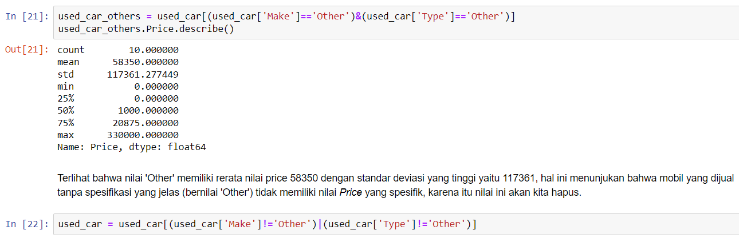
DATA CLEANING
2. Delete ‘other’ value in Make and Type feature

Slide 10
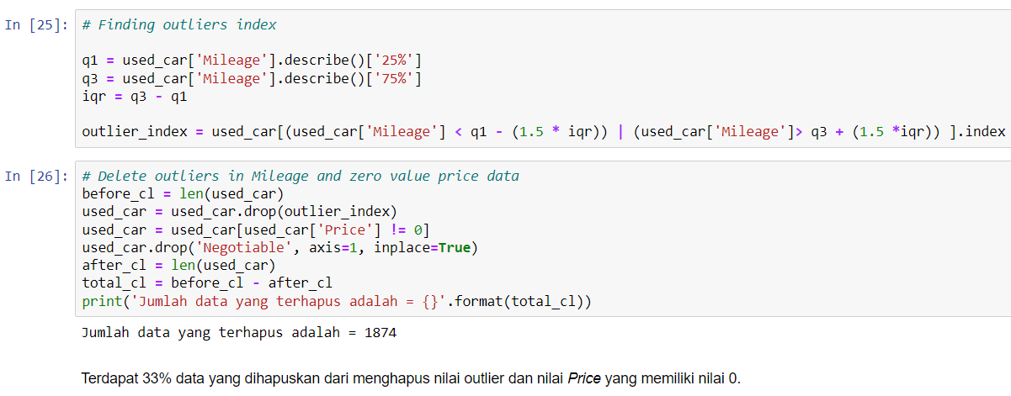
DATA CLEANING
3. Handling Outlier in Mileage, delete zero value Price and drop Negotiable features

Slide 11
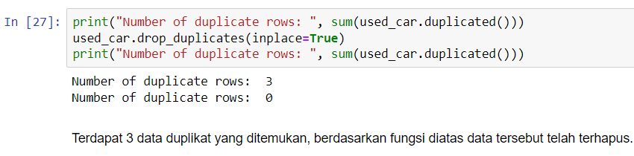

DATA CLEANING
4. Handling duplicate data
5. Delete data with price value = 1

Slide 12
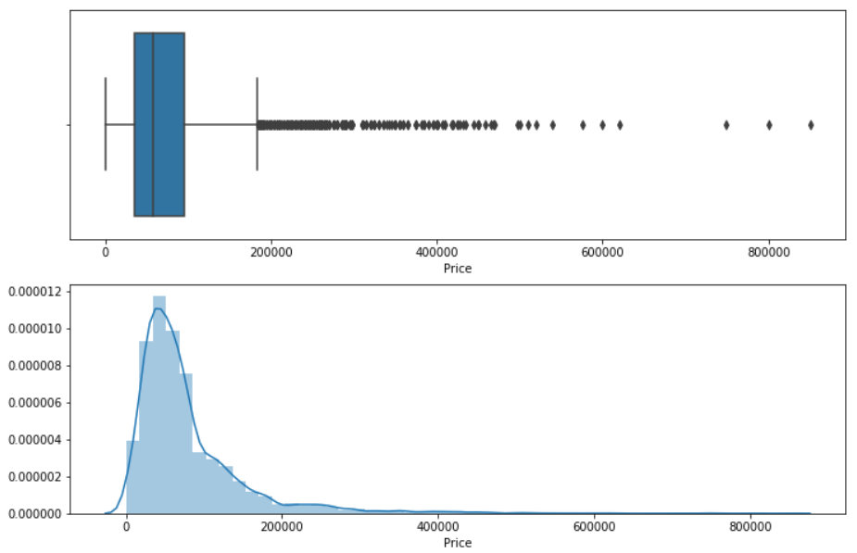
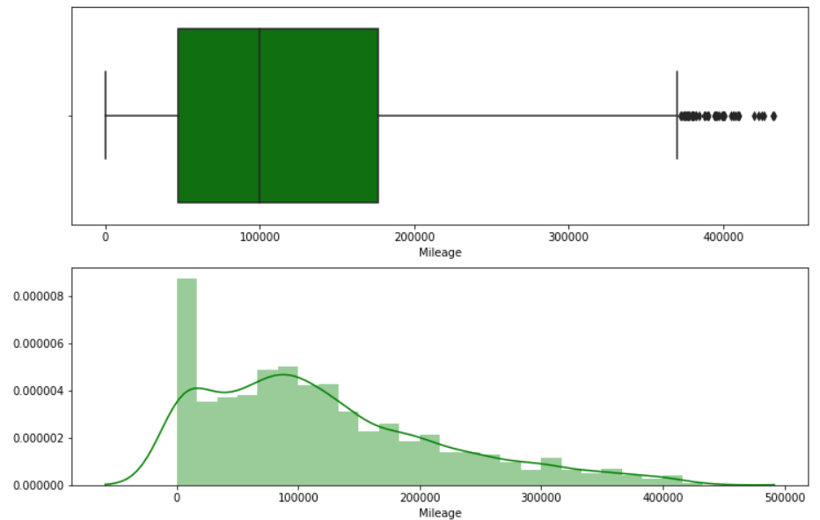
EDA
1. Feature price
2. Feature mileage

Slide 13
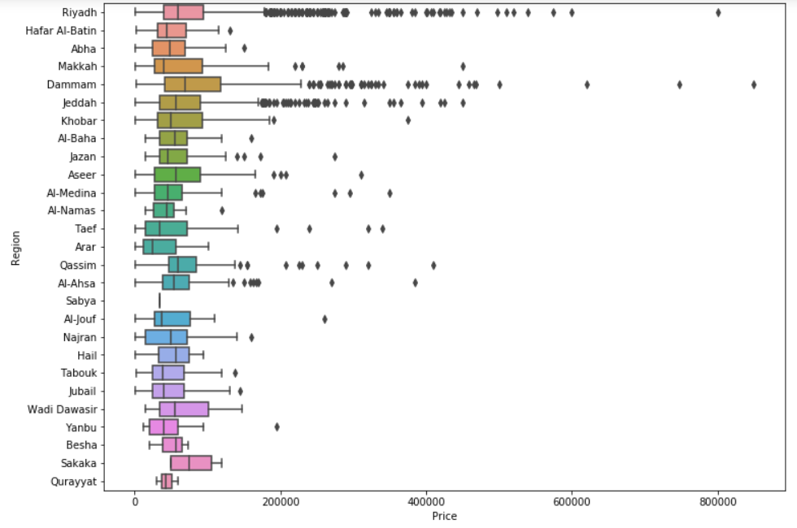
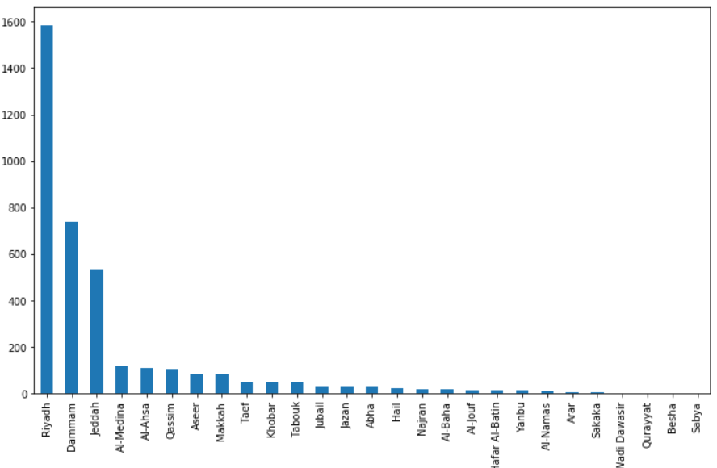
EDA
3. FEATURE REGION

Slide 14
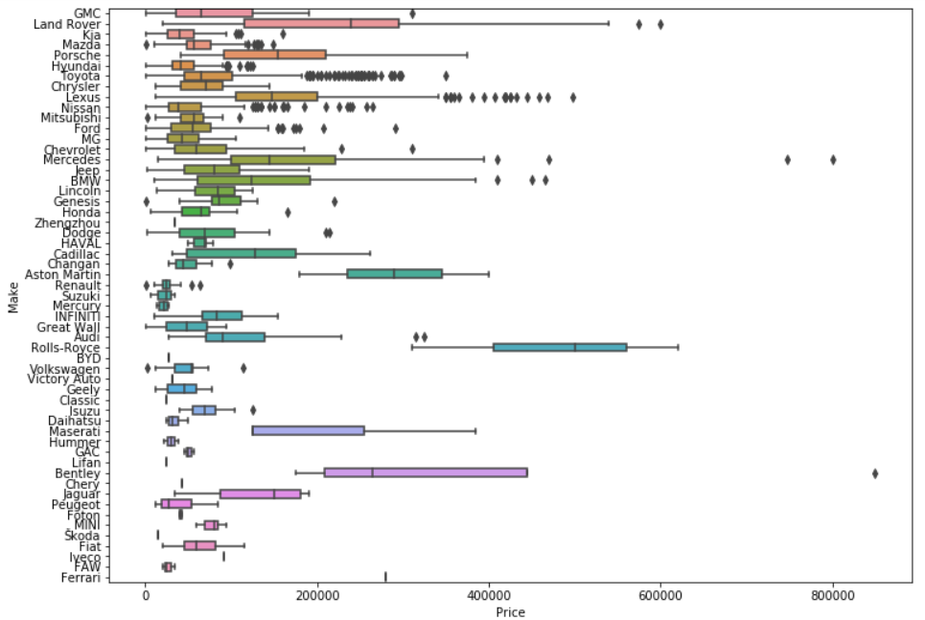
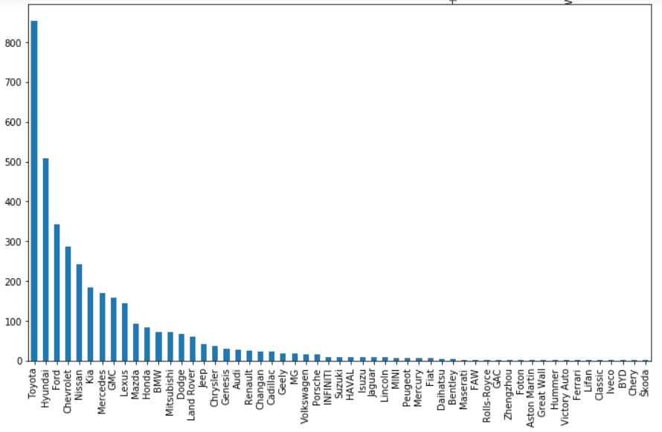
EDA
3. FEATURE MAKE

Slide 15
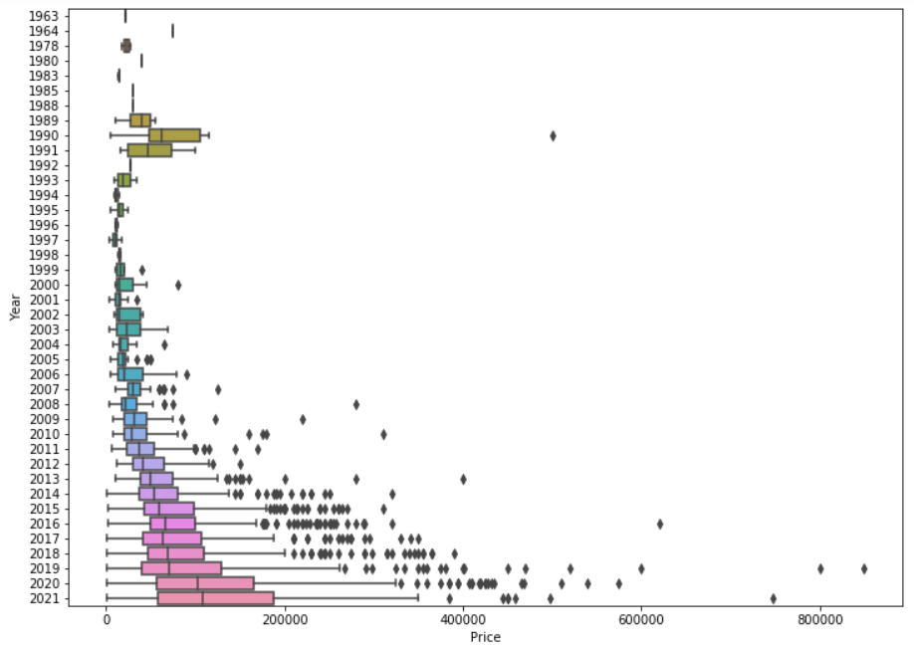
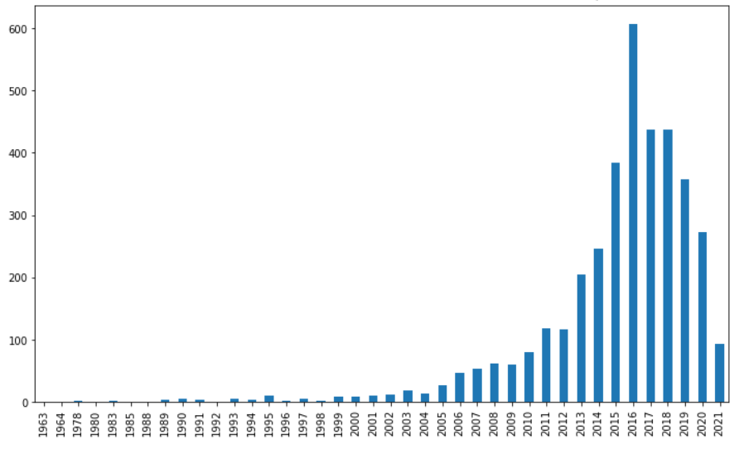
EDA
4. FEATURE YEAR

Slide 16
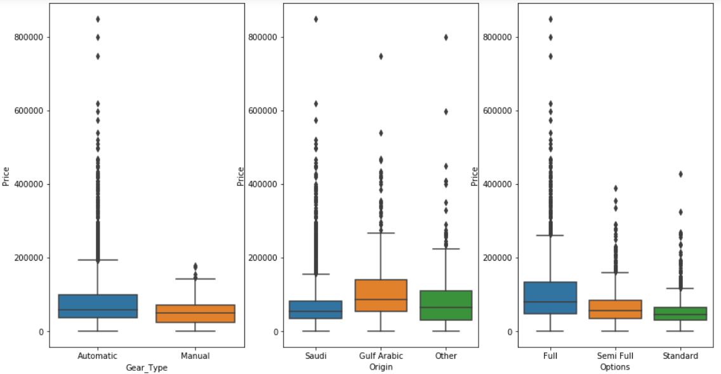
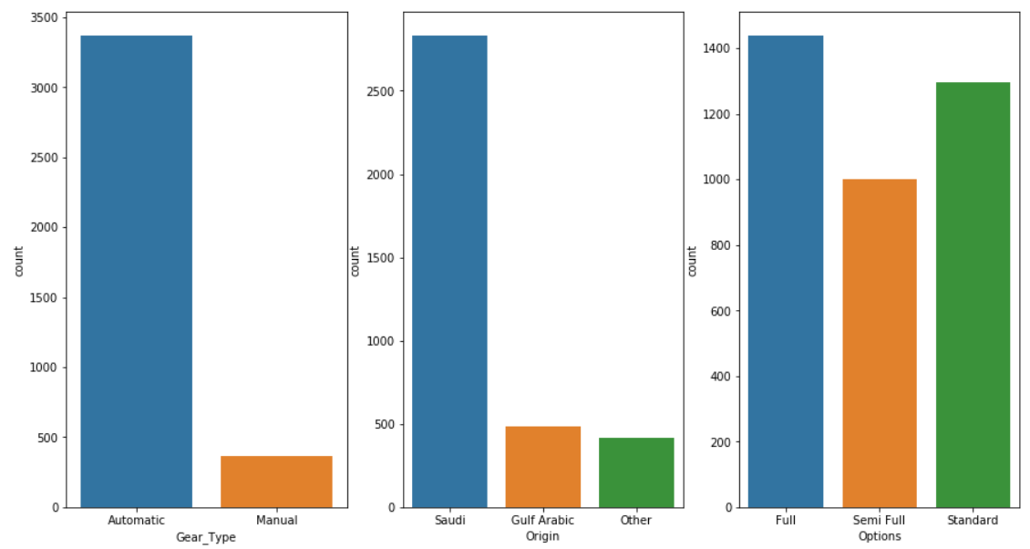
EDA
6. FEATURE GEARTYPE, ORIGIN AND OPTION

Slide 17
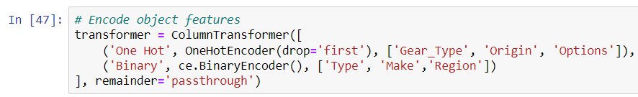
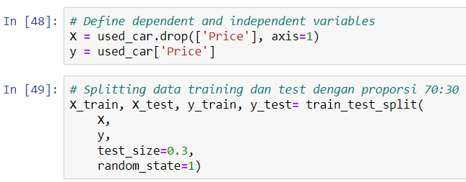
FEATURE ENGINEERING
Feature Gear_Type, Origin and Options = One Hot Encoder
Feature Type, Make, Region = Binary Encoder

Slide 18
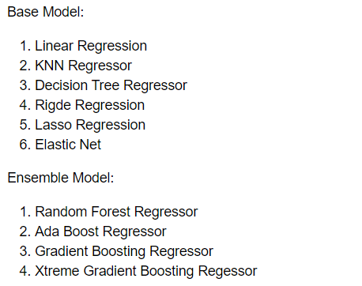
MODELING: EVALUATION
Model evaluation matrix will be Mean Absolute Error (MAE) because we see some outlier still in Price and Mileage features.

Slide 19
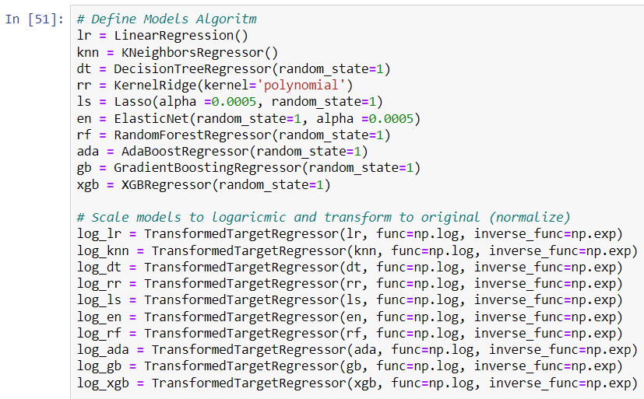
MODELING: EVALUATION

Slide 20
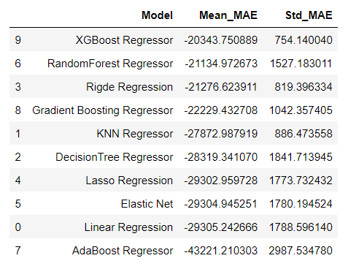
MODELING: EVALUATION
From the MAE matrix we find best models:
1. XGBoost Regressor
2. RandomForest Regressor
3. Ridge Regression
4. Gradient Boosting Regressor
5. KNN Regressor
But for RandomForest, std_MAE is too large makes model overfitting. So we will choose 4 models except for RandomForest.

Slide 21
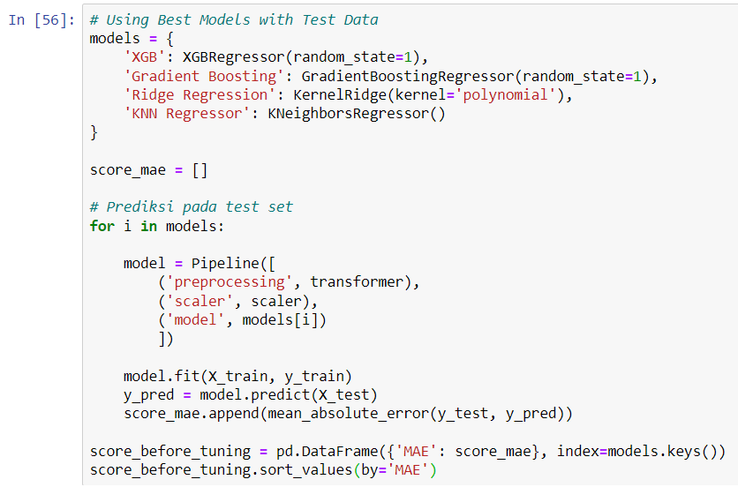
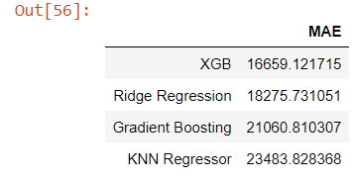
MODELING: EVALUATION
Then models are tested using Test Data, we get the best model = XGBoost Regressor.
XGBoost Regressor will be our model to predict Used Car Price

Slide 22
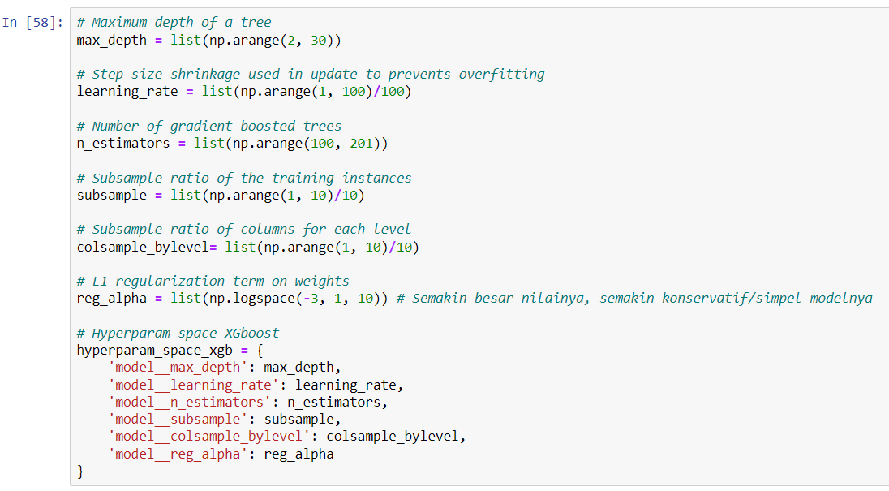
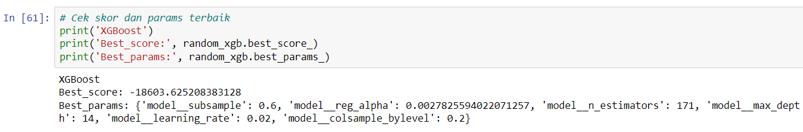
MODELING: HYPERPARAM TUNE

Slide 23
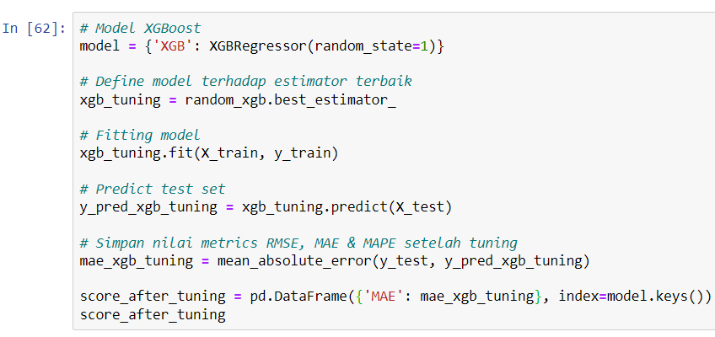

MODELING: HYPERPARAM TUNE

Slide 24
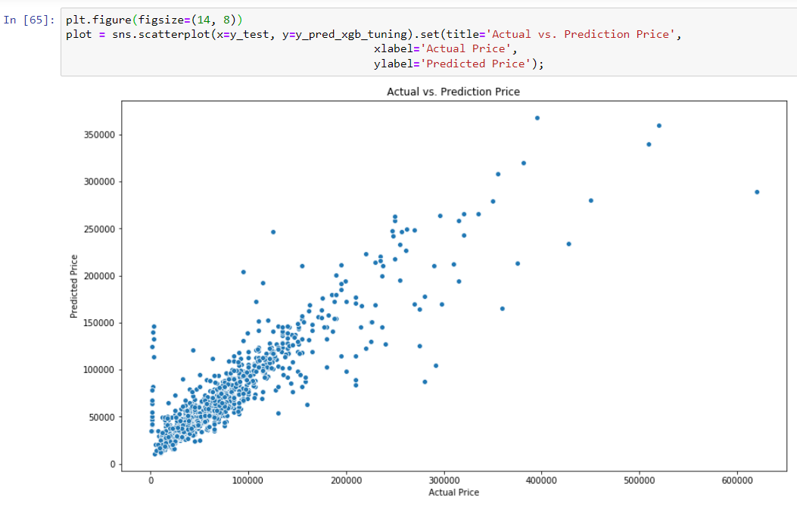
PLOT: REAL VS PREDICTED VALUE

Slide 25
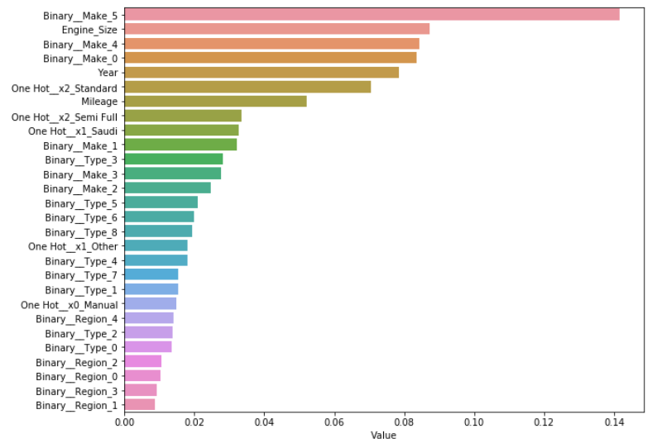
PLOT: FEATURE IMPORTANT

Slide 26
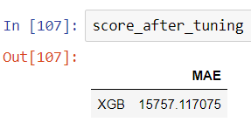
CONCLUSION
The MAE value tells that the predicted price may have a difference from the actual value (+-) 15757 SAR (MAE). For a used car with a high price (max Price 850000 SAR) the resulting error value (RMSE and MAE) will look small (1.8%), but for a used car with a low price (min Price 500 SAR) the error value will be very large . Therefore, this model can be improved by providing a higher minimum value limit on Price data.
Overall this model is good enough to predict the price of a used car, both for used car sellers and buyers. For example, this model can be used by website Syarah.com that sell used cars so customers can decide to the sell/purchase used car and increase the number of transactions in the website.

Slide 27
RECOMMENDATION
1. Provide a minimum limit for a higher price value, because there are several large errors for the Price prediction value at a low price. Or you can also split the model into 2 types for high and low prices with each different model.
2. Analyzing the collinearity of the features used in the modeling by calculating the VIF of each feature,
3. Using the polynomial on features to get a more sensitive model.

Slide 28
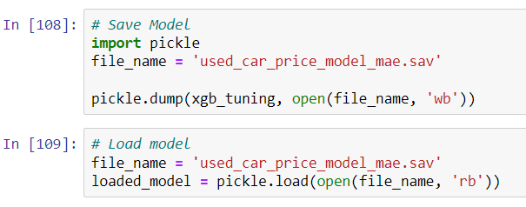
SAVE MODEL WITH PICKLE

Slide 29
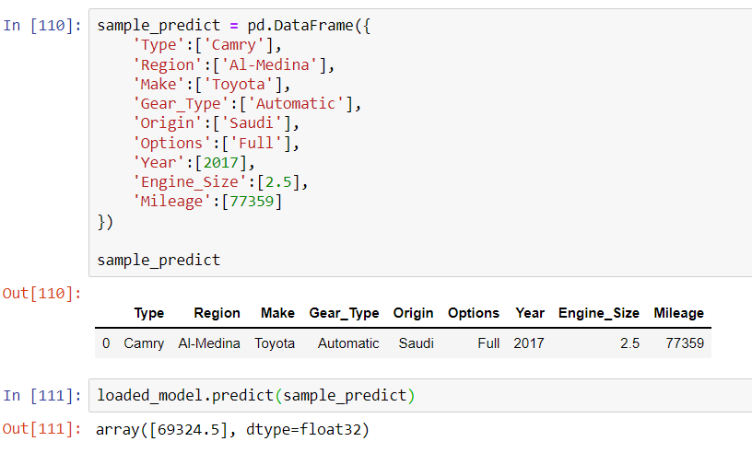
EXAMPLE CASE

Slide 30
Thank you”
- Risdan kristori

